Slide 1
PIG LATIN Commands
By – mayur jain

Slide 2
EXECUTION MODES
Apache Pig Execution Modes
You can run Apache Pig in two modes, namely, Local Mode and HDFS mode.
Local Mode
In this mode, all the files are installed and run from your local host and local file system. There is no need of Hadoop or HDFS. This mode is generally used for testing purpose.
MapReduce Mode
MapReduce mode is where we load or process the data that exists in the Hadoop File System (HDFS) using Apache Pig. In this mode, whenever we execute the Pig Latin statements to process the data, a MapReduce job is invoked in the back-end to perform a particular operation on the data that exists in the HDFS.
Apache Pig Execution Mechanisms
Apache Pig scripts can be executed in three ways, namely, interactive mode, batch mode, and embedded mode.

Slide 3
Interactive Mode (Grunt shell) − You can run Apache Pig in interactive mode using the Grunt shell. In this shell, you can enter the Pig Latin statements and get the output (using Dump operator).
Batch Mode (Script) − You can run Apache Pig in Batch mode by writing the Pig Latin script in a single file with .pig extension.
Embedded Mode (UDF) − Apache Pig provides the provision of defining our own functions (User Defined Functions) in programming languages such as Java, and using them in our script.

Slide 4
Pig Latin – Basics
Pig Latin is the language used to analyze data in Hadoop using Apache Pig. In this chapter, we are going to discuss the basics of Pig Latin such as Pig Latin statements, data types, general and relational operators, and Pig Latin UDF’s.
Pig Latin – Data Model
As discussed in the previous chapters, the data model of Pig is fully nested. A Relation is the outermost structure of the Pig Latin data model. And it is a bag where −
A bag is a collection of tuples.
A tuple is an ordered set of fields.
A MAP is a piece of data.

Slide 5

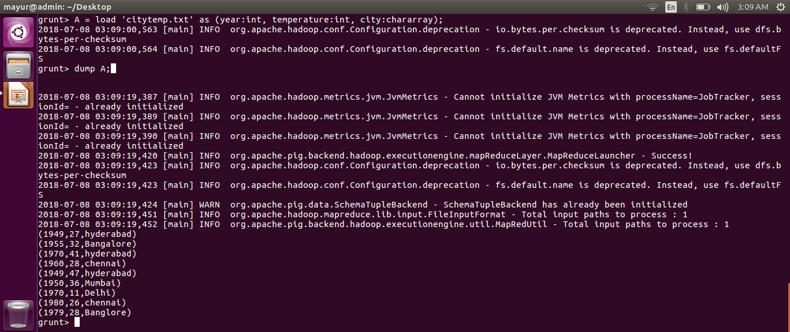
PIG LATIN -EXAMPLE
Load Command
This command is used to load data from the Hadoop file system into a relation.
Command: variable_name = LOAD ‘data path’ AS (schema);
Dump Command
This command prints a relation to the console.
Command: dump variable_name;.

Slide 6
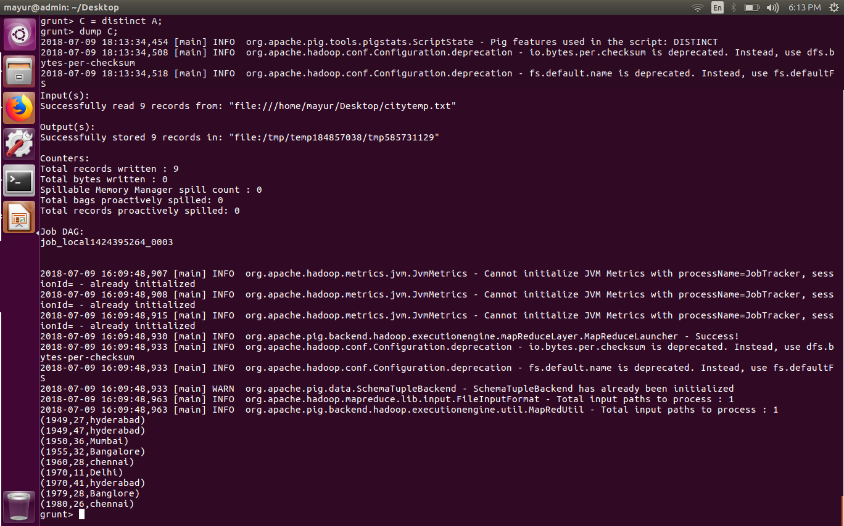
RELATIONAL OPERATOR
This command is used to remove duplicate rows from a relation.
Command: distinct1 = DISTINCT variable_name;

Slide 7
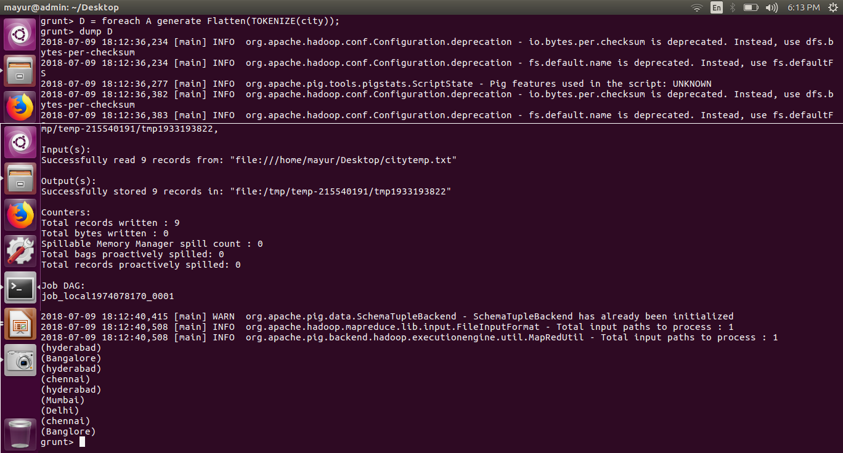
FOREACH, GENERATE to generate data transformations based on columns of data.

Slide 8
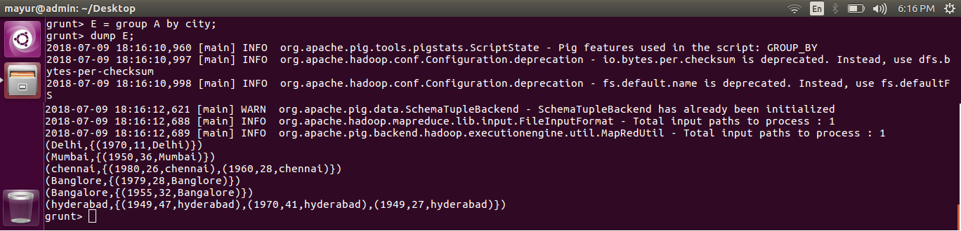
GROUP to group the data in a single relation.

Slide 9
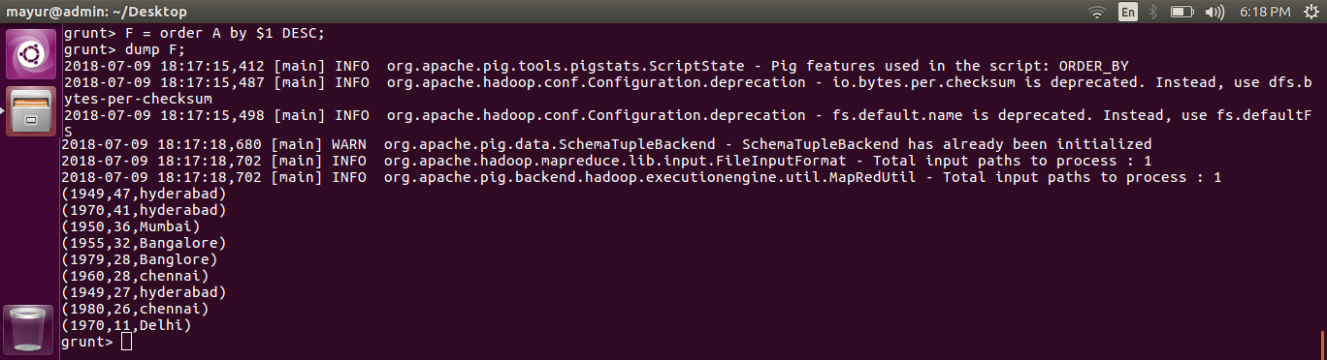
ORDER to arrange a relation in a sorted order based on one or more fields (ascending or descending).

Slide 10
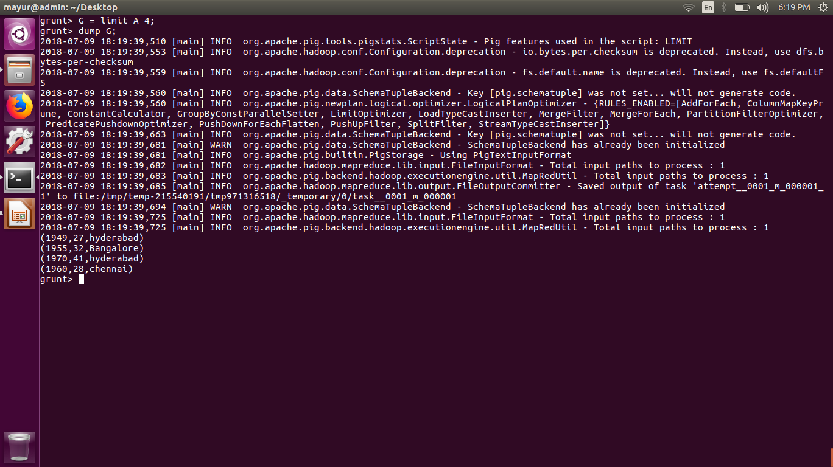
LIMIT to get a limited number of tupels from a relation.

Slide 11
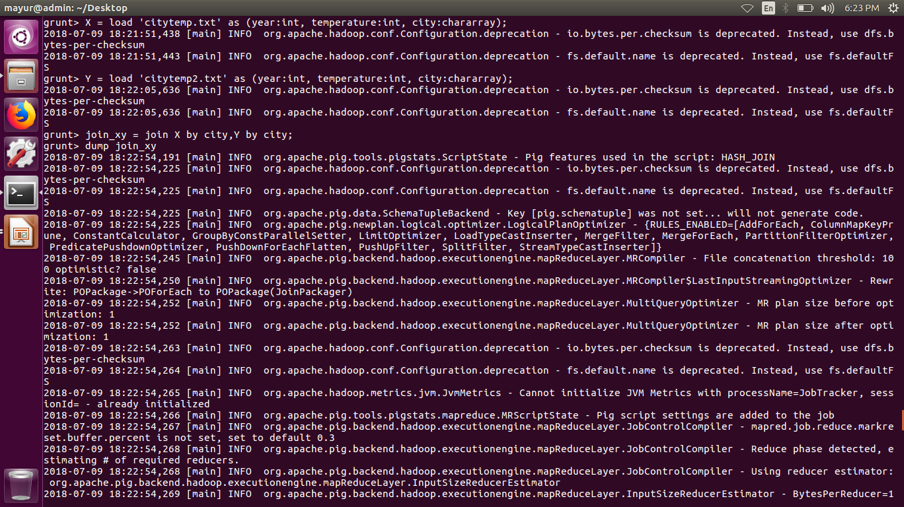
UNIOn + cross + join commands

Slide 12
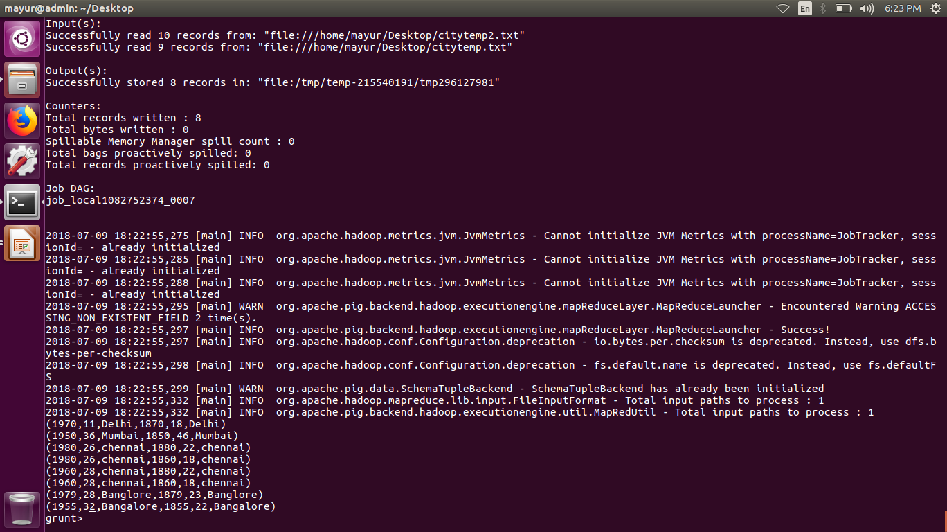

Slide 13
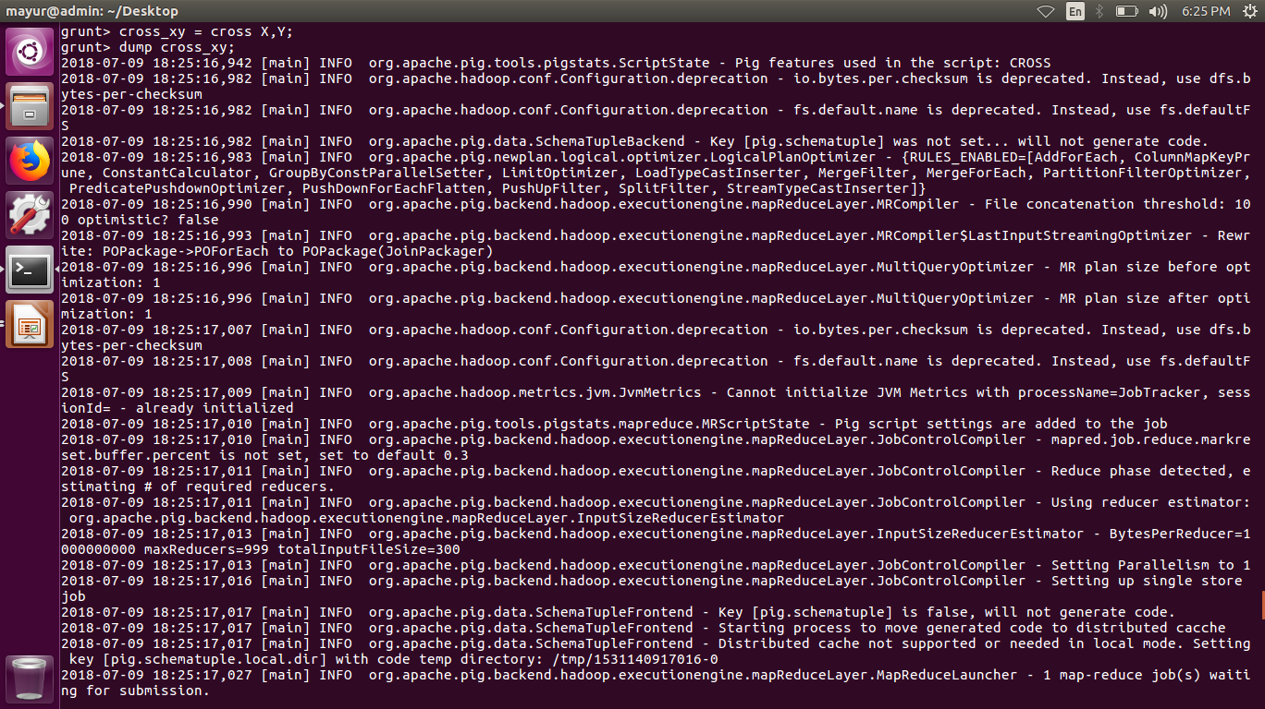

Slide 14
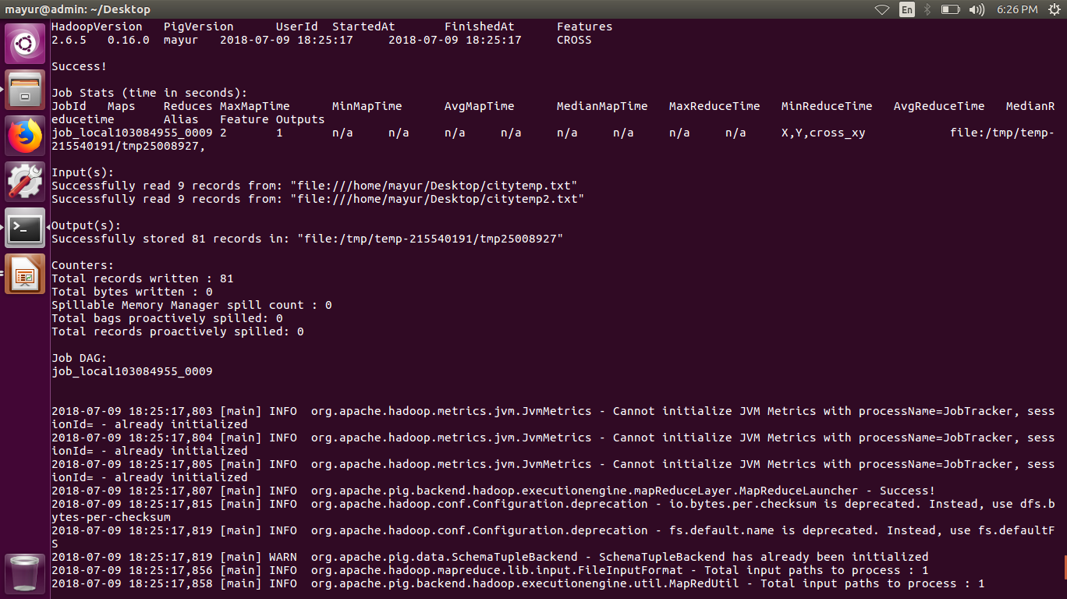

Slide 15

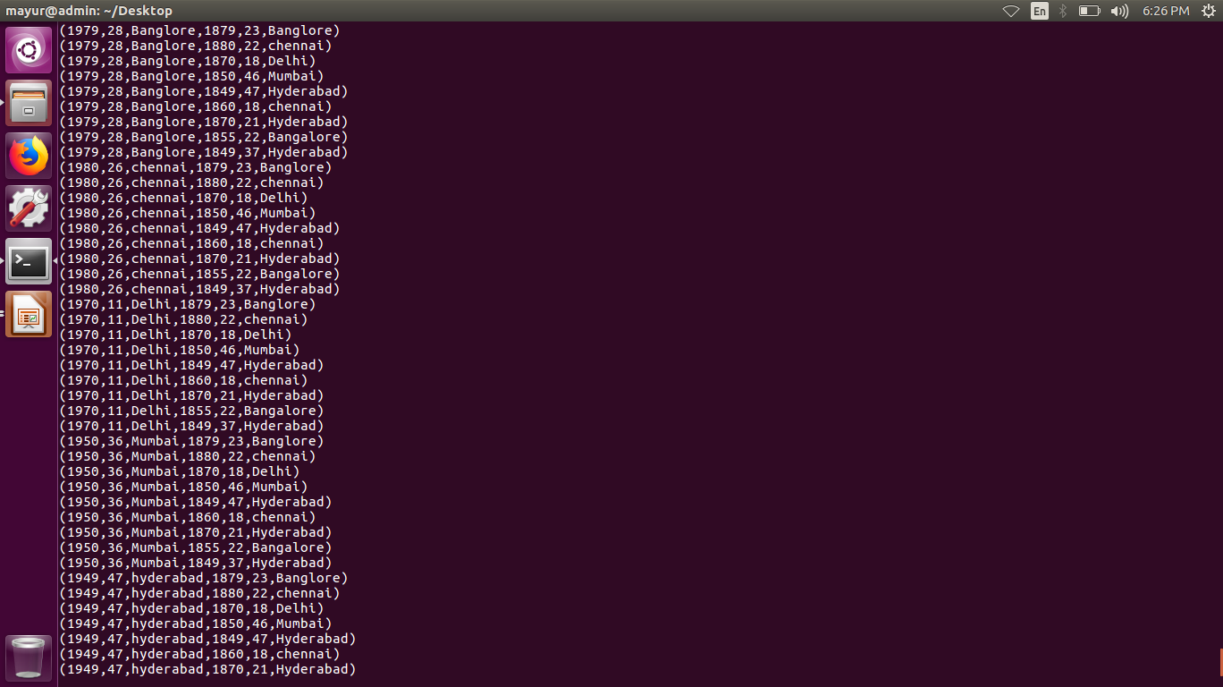
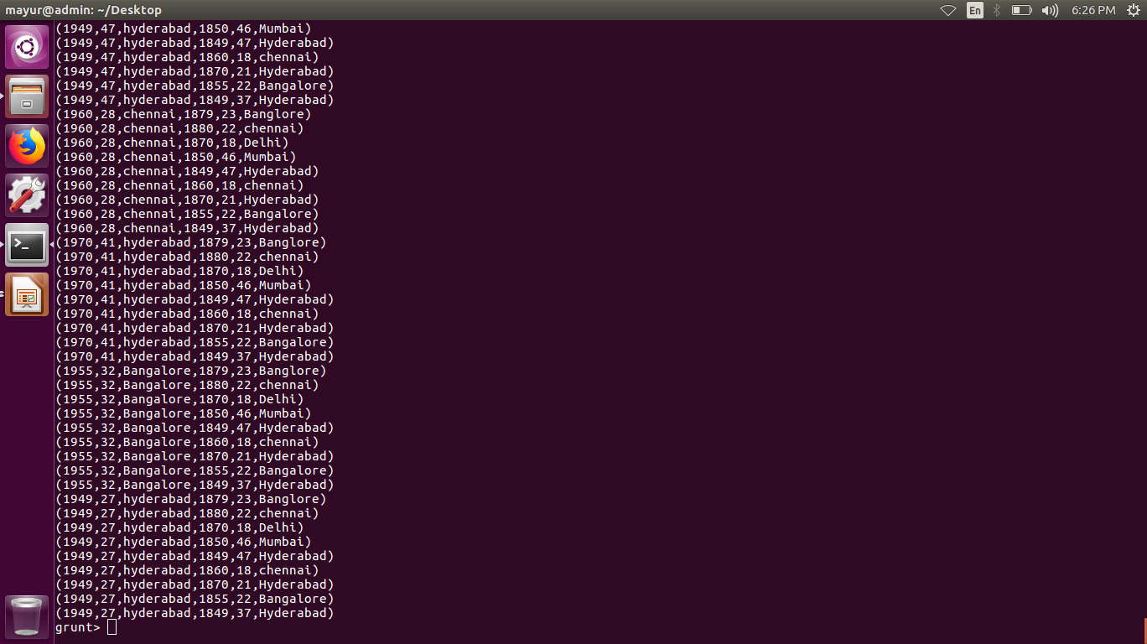

Slide 16
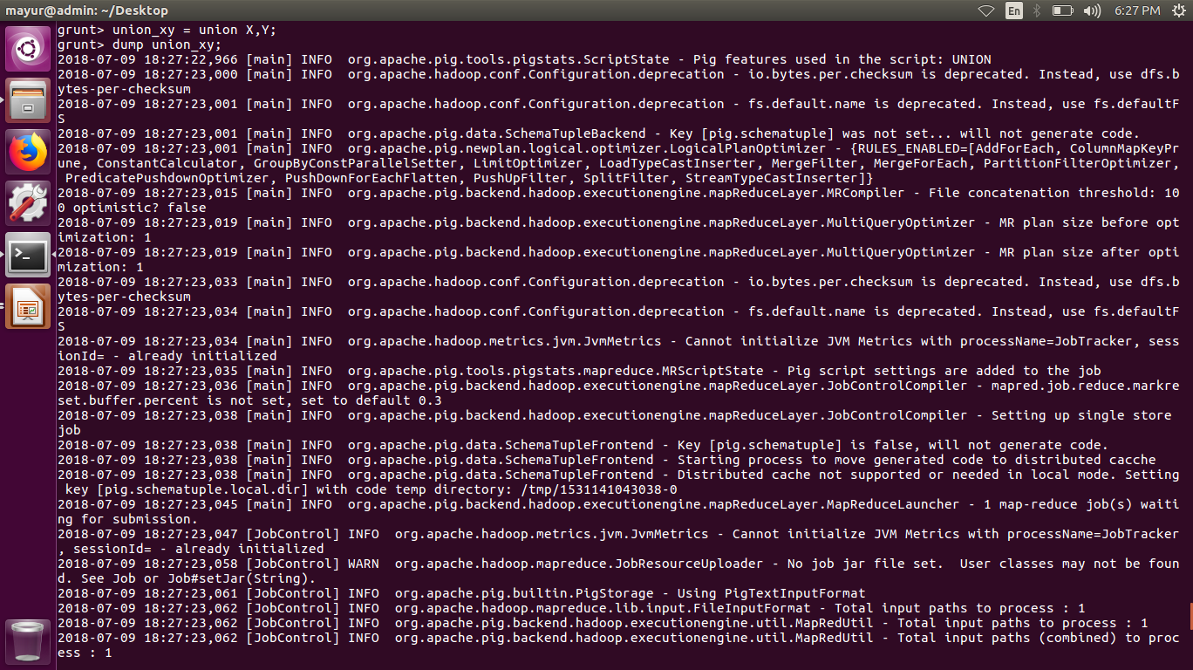

Slide 17
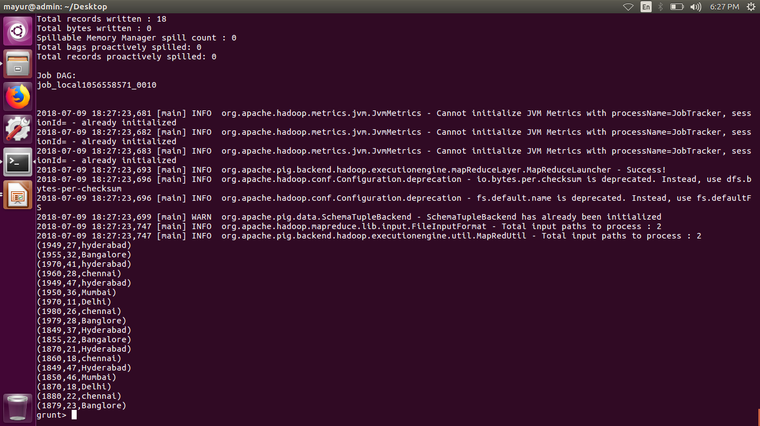

Slide 18
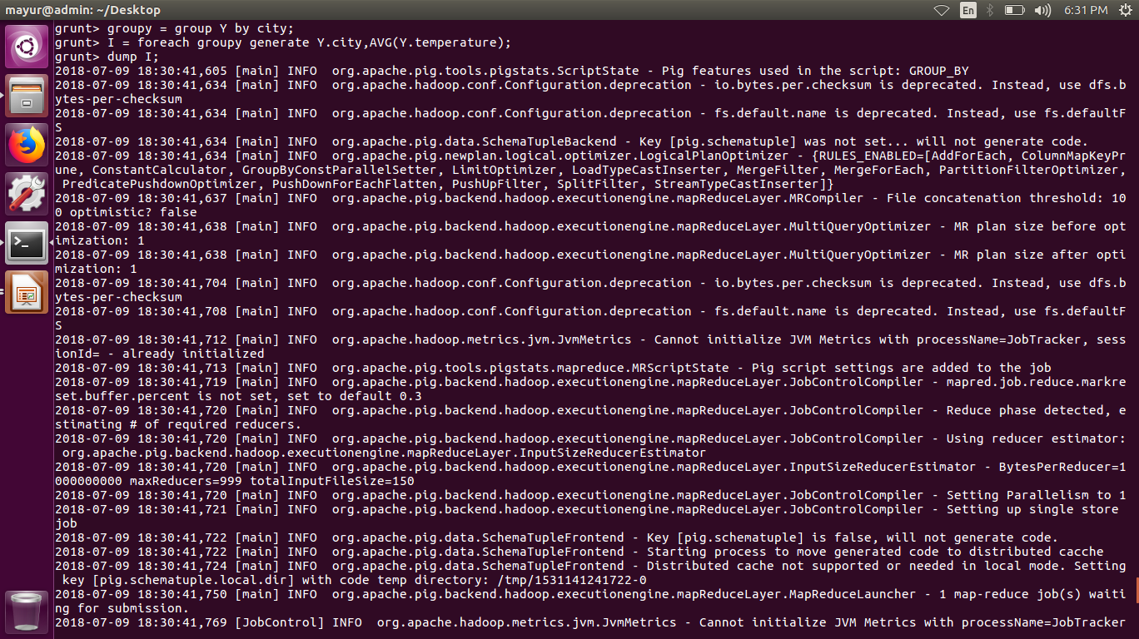

Slide 19
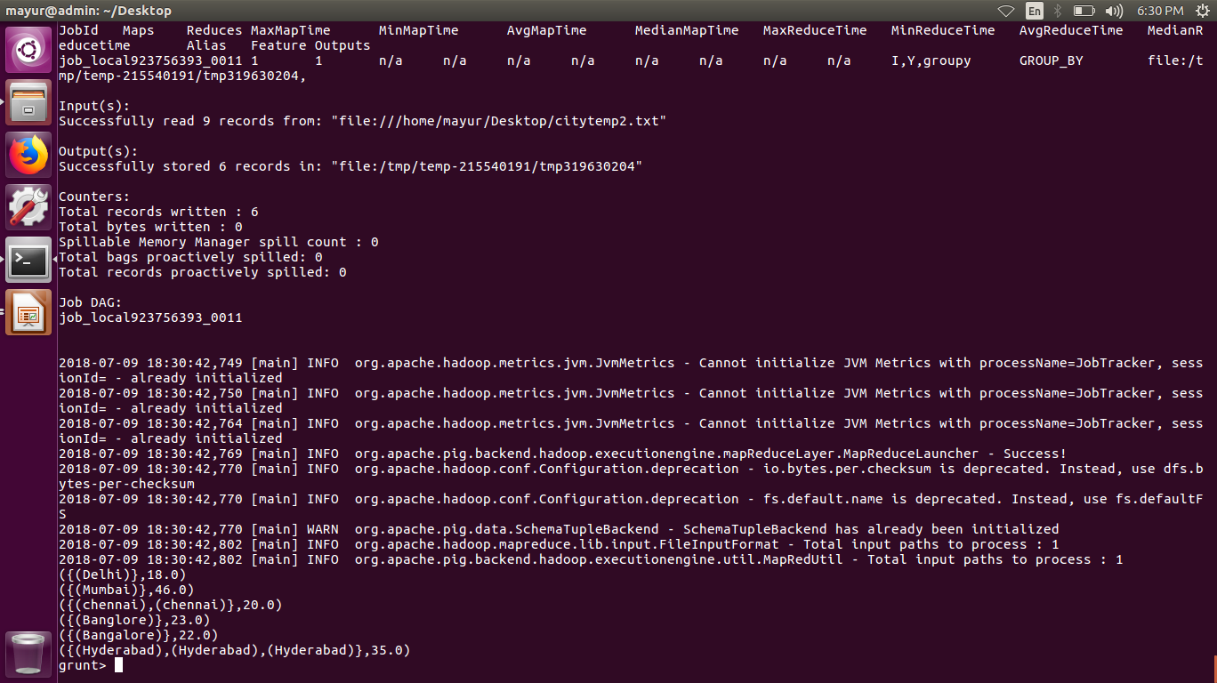

Slide 20
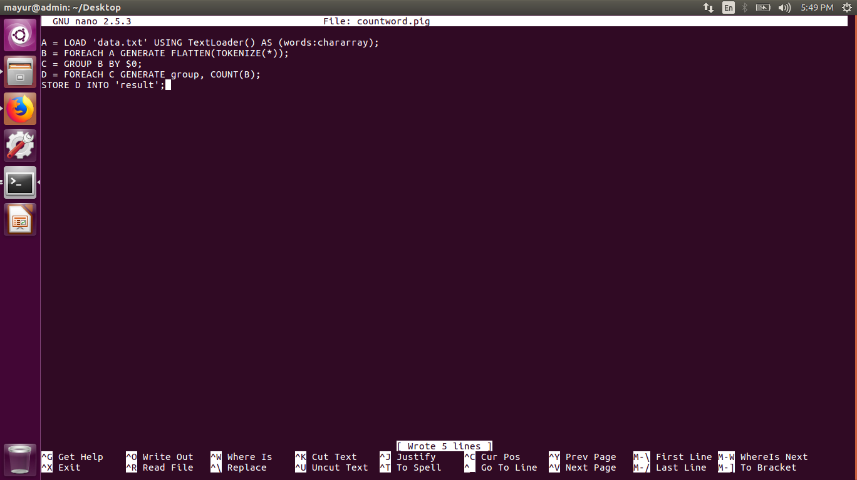

Slide 21
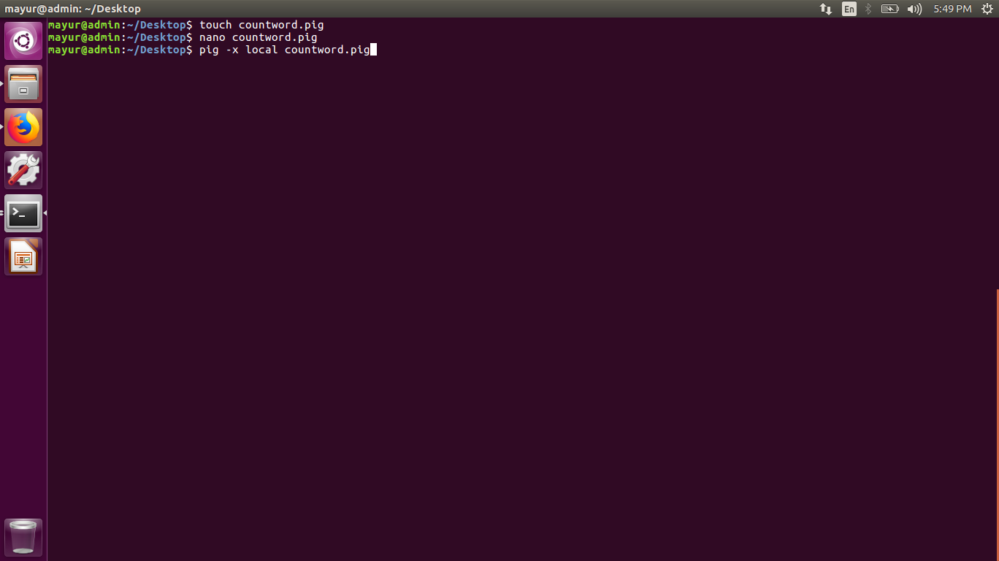

Slide 22
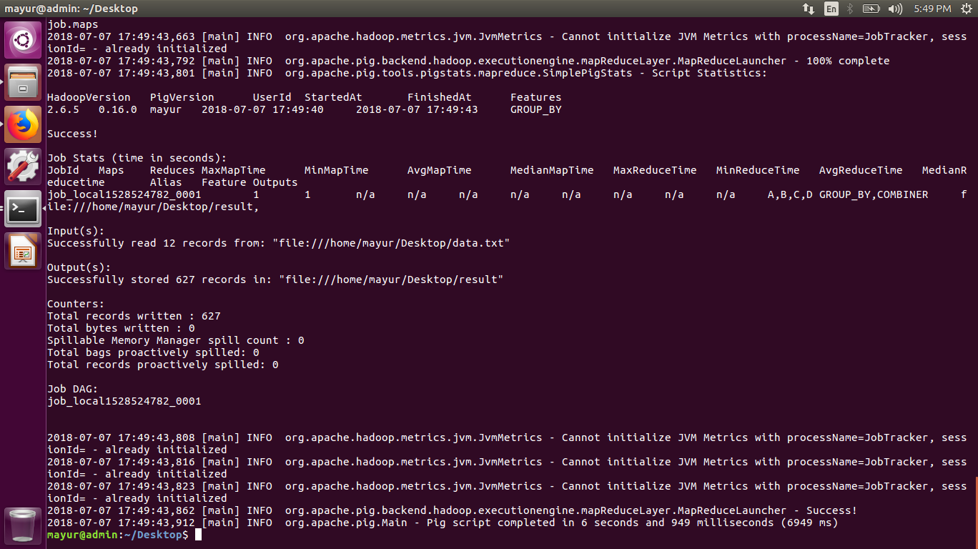

Slide 23
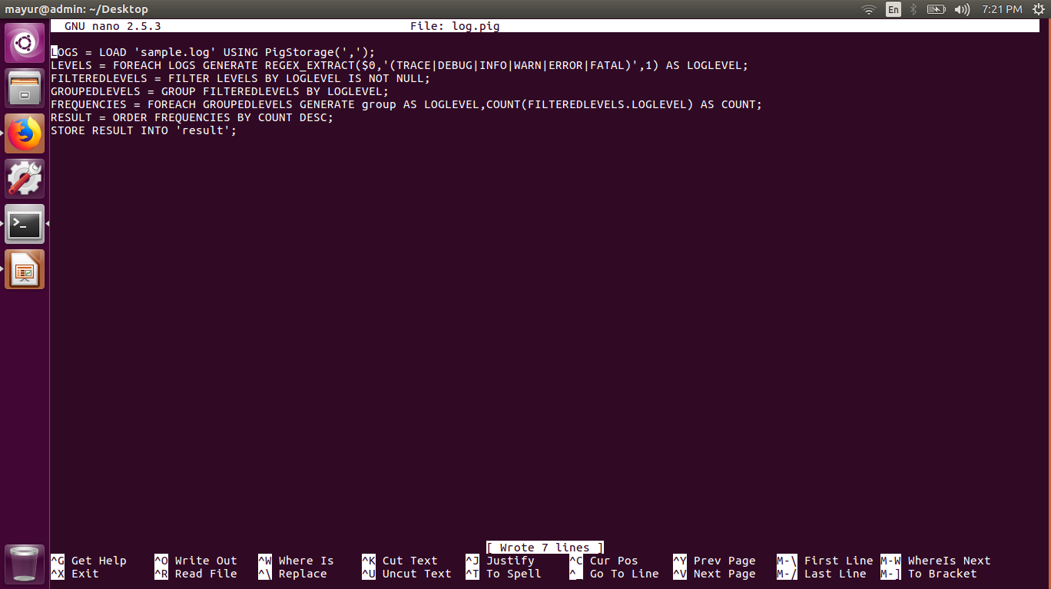

Slide 24
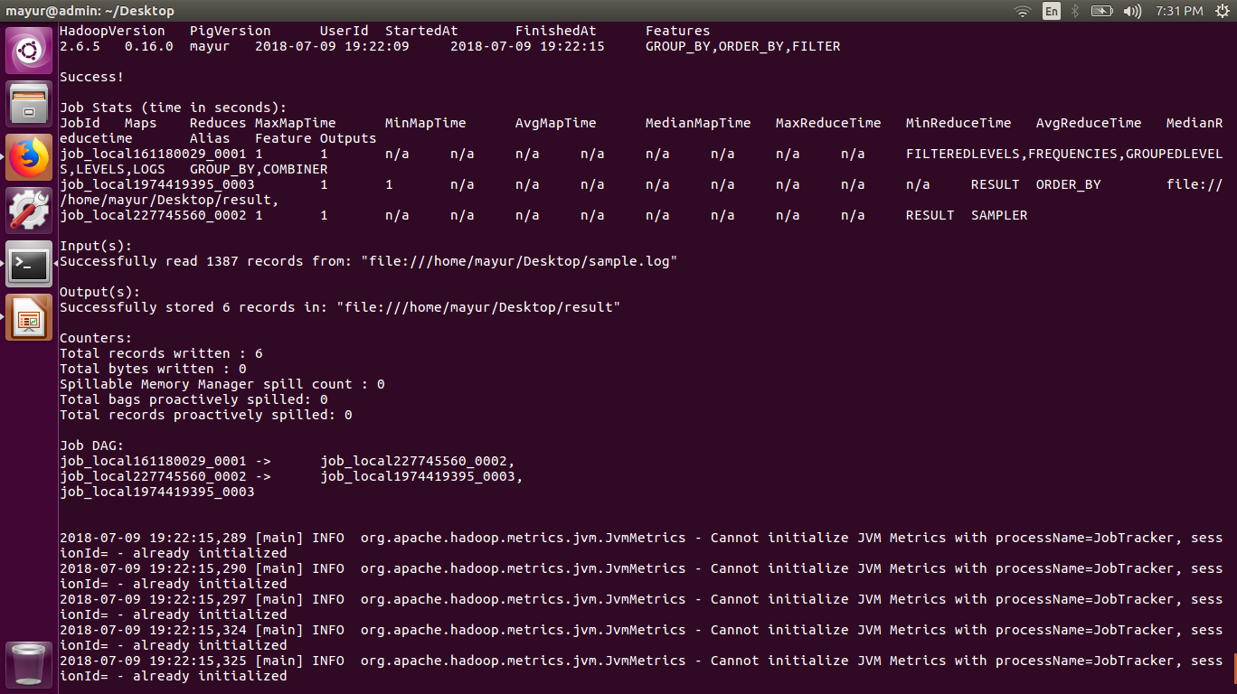

Slide 25
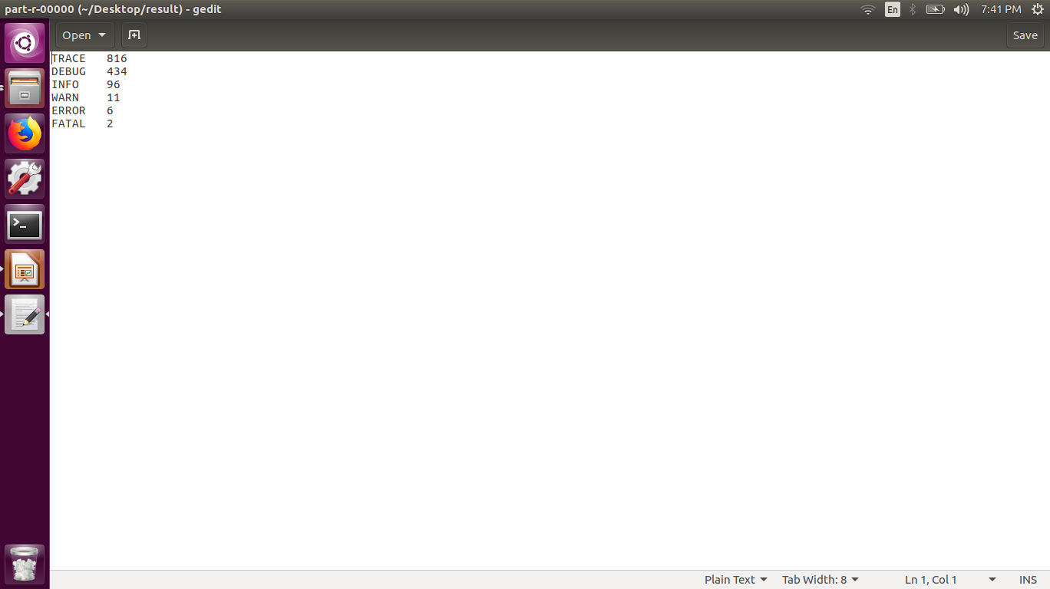

Slide 26


